Slide 1
IT11L COMPUTER NETWORK LESSON 3

Slide 2

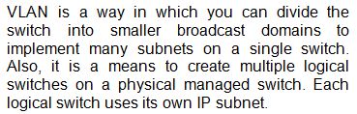

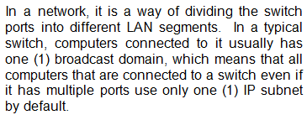
VIRTUAL LOCAL AREA NETWORK (VLAN)

Slide 3

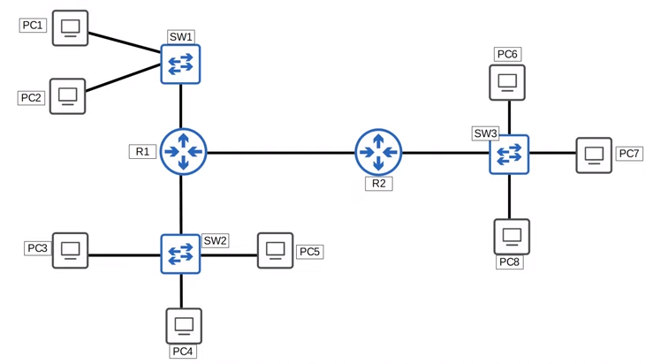

LOCAL AREA NETWORK (LAN) BROADCAST DOMAIN

Slide 4

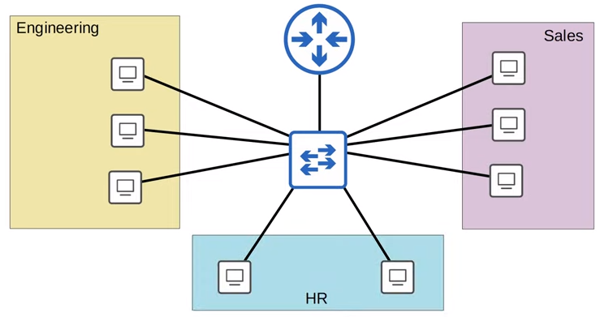



LOCAL AREA NETWORK (LAN) BROADCAST DOMAIN

Slide 5


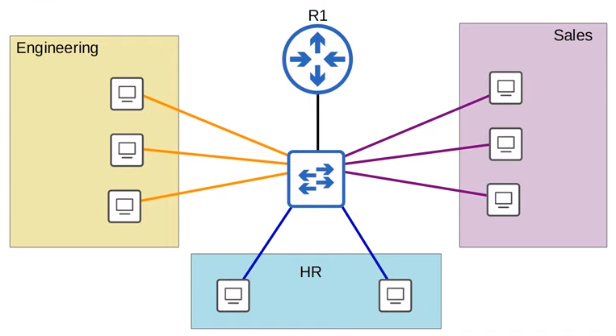

LOCAL AREA NETWORK (LAN) BROADCAST DOMAIN

Slide 6


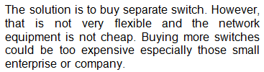
LOCAL AREA NETWORK (LAN) BROADCAST DOMAIN

Slide 7



VIRTUAL LOCAL AREA NETWORK (VLAN)

Slide 8
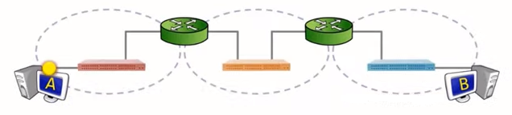
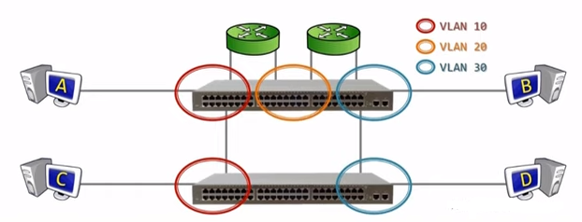
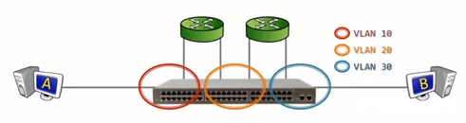
VIRTUAL LOCAL AREA NETWORK (VLAN)

Slide 9

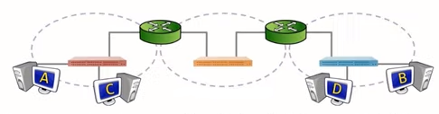

VIRTUAL LOCAL AREA NETWORK (VLAN)

Slide 10


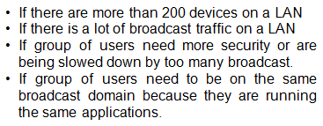
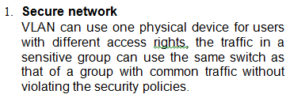
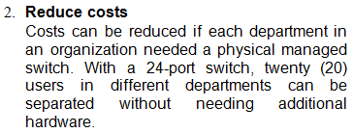
VIRTUAL LOCAL AREA NETWORK (VLAN)

Slide 11
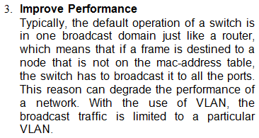


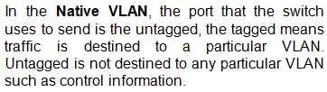
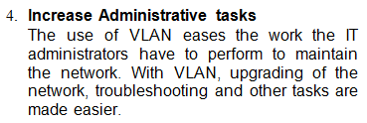

VIRTUAL LOCAL AREA NETWORK (VLAN)

Slide 12


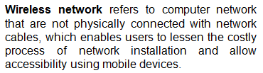

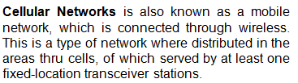

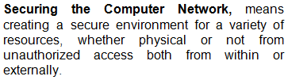
WIRELESS NETWORK SECURITY PRINCIPLES, PROTOCOLS, & STANDARDS

Slide 13

WIRELESS NETWORK SECURITY PRINCIPLES, PROTOCOLS, & STANDARDS
TCP/IP | OSI | Security Protocols
Application | Application Presentation Session | Remote Authentication Dial-In User Service (RADIUS) Terminal Access Controller Access Control System (TACACS+) Pretty Good Privacy (PGP) Secure / Multipurpose Internet Mail Extension (S/MIME) Secure HTTP (S-HTTP) Hypertext Transfer Protocol over Secure Socket Layer (HTTPS) Secure Electronic Transactions (SET) Kerberos

Slide 14
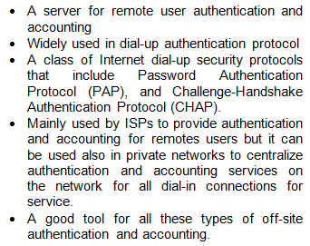
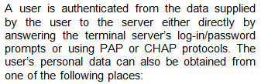
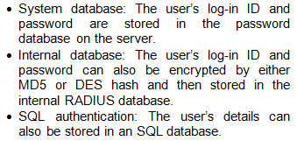
COMPUTER NETWORK SECURITY PROTOCOLS APPLICATION-LEVEL SECURITY

Slide 15
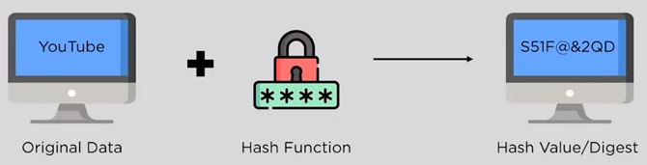
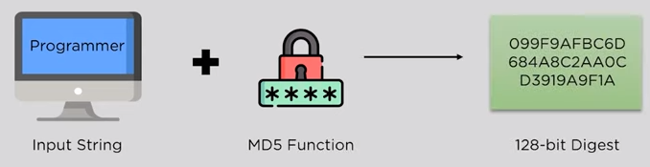

COMPUTER NETWORK SECURITY PROTOCOLS APPLICATION-LEVEL SECURITY

Slide 16

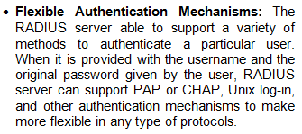


COMPUTER NETWORK SECURITY PROTOCOLS APPLICATION-LEVEL SECURITY

Slide 17


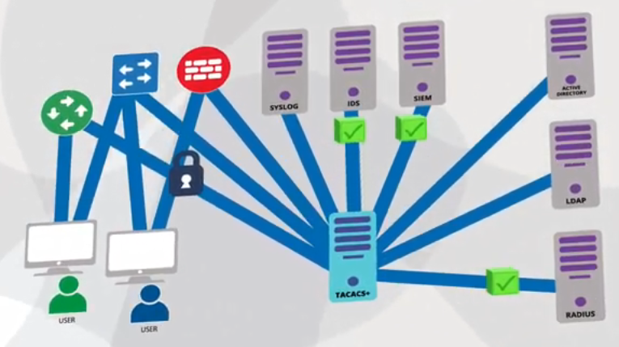

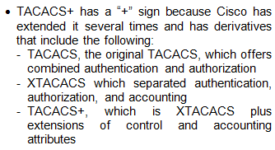
COMPUTER NETWORK SECURITY PROTOCOLS APPLICATION-LEVEL SECURITY

Slide 18
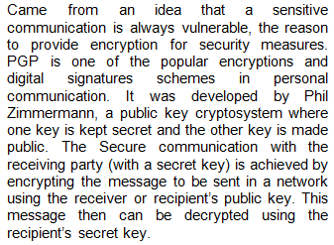

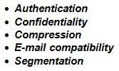
COMPUTER NETWORK SECURITY PROTOCOLS APPLICATION-LEVEL SECURITY

Slide 19

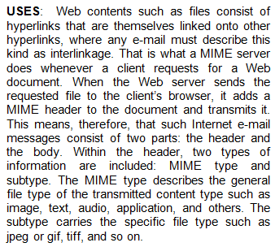

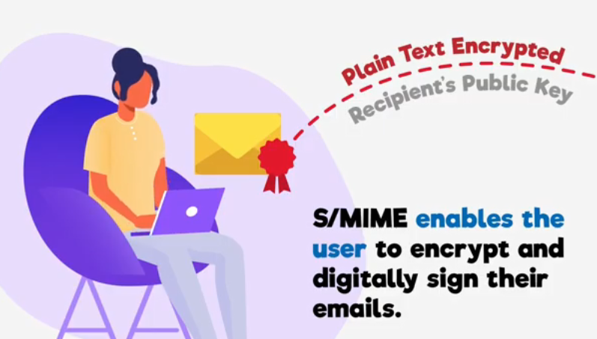
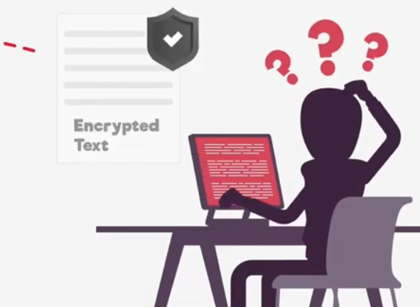
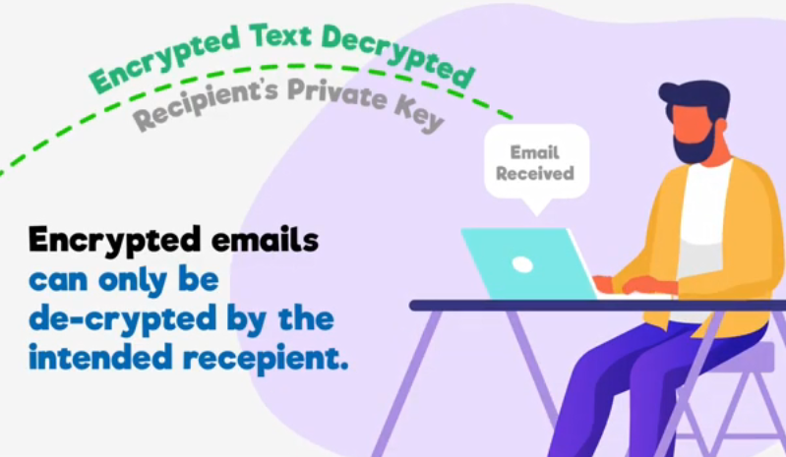

COMPUTER NETWORK SECURITY PROTOCOLS APPLICATION-LEVEL SECURITY

Slide 20
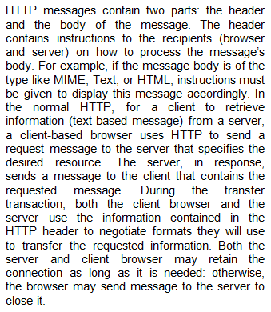
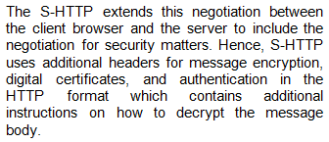
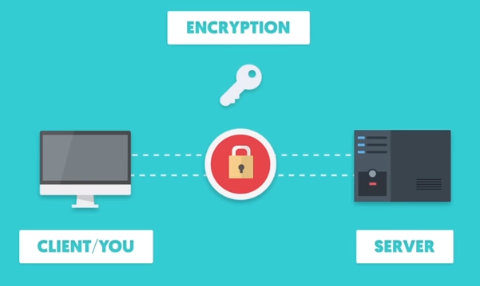
COMPUTER NETWORK SECURITY PROTOCOLS APPLICATION-LEVEL SECURITY

Slide 21
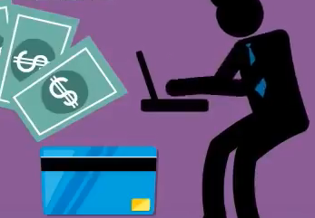
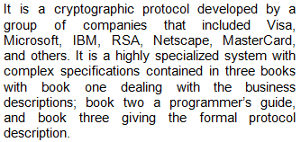
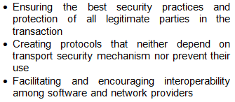
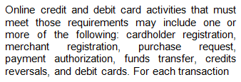

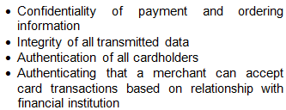

COMPUTER NETWORK SECURITY PROTOCOLS APPLICATION-LEVEL SECURITY

Slide 22
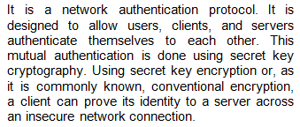


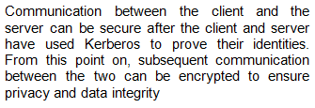
COMPUTER NETWORK SECURITY PROTOCOLS APPLICATION-LEVEL SECURITY

Slide 23
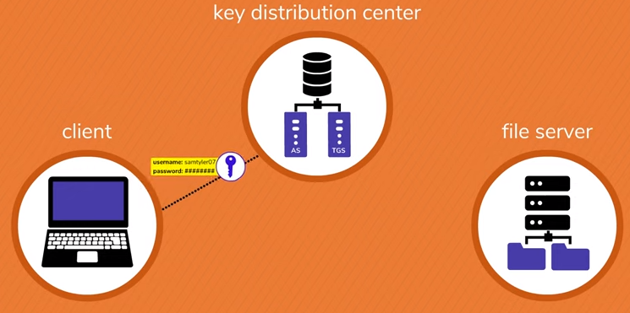

COMPUTER NETWORK SECURITY PROTOCOLS APPLICATION-LEVEL SECURITY

